Slide 1



SafeHaven tm
A Proposal for an FDIC Insured Capital Preservation Product for the DC Market
https://insuredretirementinvestments.com/
Contents confidential. Do not copy or distribute.

Slide 2
SafeHaven: The best Capital Preservation Investment Option for Plan Participants
Overview
The SafeHaven FDIC Insured CIT Funds for Retirement Plans is set to launch late fall of 2024
SafeHaven is the only FDIC Insured Capital Preservation Product for Retirement Plans in the
popular , easy to trade and access CIT form.
SafeHaven expressly designed to compete with Stable Value offerings that comprise an estimated $300
billion of participant 401k balances
Stable Value Funds are weak and getting weaker. SafeHaven will outperform on rate by 250 basis points,
but only SafeHaven is truly safe. SV Funds have failed , but no FDIC Depositor has ever lost a penny
Plan participants have the same goals as other brokerage customers: Safety First. As participants
age their asset allocation becomes remarkably more conservative

Slide 3

More about SafeHaven Product Features
  Summary of Product Features
  SafeHaven invests participant cash balances in deposits of FDIC Insured Banks.
  SafeHaven is FDIC Insured up to 1.5 million per plan participant. ERISA allows FDIC Insurance pass thru
  SafeHaven is currently competitive with the highest yielding Stable Value Funds and outperforms many.
  Back Tested performance equivalent or superior for 1,3 , and 5 year periods including negative sloped yield curve cycles for both SV and MM funds
  Daily liquidity, Benefit responsive, short outs
  SafeHaven is available both as a Common Investment Trust with various “classes”, and as a Bank Trust thru a major Trust
  Product Differentiation
  First Mover Advantage: Providing an FDIC Insured Cash alternative makes the Investment Advisor 401k product stand out . Few firms offering
  By adopting SafeHaven , an early adopting Investment Advisor will insulate participants from potential limitations of Stable Value Fund availability if there is a sudden major move back into cash from equities
  Money Market Funds will be unable to keep up with SafeHaven if interest rates rise and the yield curve provides a benefit for extended duration
An Investment Advisor has an opportunity to further
differentiate from competitors by adopting innovative
best in class product

Slide 4
Perspective: There is nothing like FDIC Insurance
  Context: SafeHaven FDIC Deposit Market
  SafeHaven is a close cousin of FDIC Insured Brokerage Cash products where hundreds of banks have taken an estimated $1 trillion in deposits. SafeHaven is simply reformulated to comply with ERISA and operate on retirement platforms
  The SafeHaven team and associates have placed more than 80 billion of similar product and manage 50 plus billion today
  Brokerage Cash Balances are back to all time high of 10%
  Brokerage cash balances increased 60% amidst market corrections during the financial crisis to 10% from avg of 6%
  During the last major market move several SV funds went under , wrap capacity shrunk when it needed to expand, leaving participants and their Advisors hi and dry
Despite the financial crisis and some
Banks failing, bank use of wholesale
deposits grew. Capacity was preserved

Slide 5
A Fiduciary’s Perspective : SafeHaven vs Stable Value and Money Market Funds
  IRI reviews hundreds of banks quarterly with proprietary tools that predict quality and capital downgrades and allows a graceful non- intrusive exit from deteriorating credits.
  SafeHaven has active relationships with over 100 banks taking more than 50 billion in deposits. Our approach identifies which banks are most likely to pay a premium for the types of deposits emanating from Retirement Plan cash balances. We gain a 15 to 25 basis point advantage compared to relevant swap rates
  SafeHaven expenses are 15 to 35 basis points below Stable Value Funds before Distribution Expenses, due to comparative efficiencies of the deposit market compared to the depth and reliability of the wrap market used by Stable Value Funds
  All SafeHaven deposits are FDIC Insured. Both principal and interest are fully protected. Even if our filters and methods fail to detect deteriorating conditions, the money is safe. Simply the safest principal preservation product available
Active versus Passive
Alpha versus Beta In a Cash Product
Cost Matters
First, Do No Harm

Slide 6
Cash Products are an important but often ignored 401k asset class
  Retirement plans have 5 trillion in 401k balances
  investment balances 7% in Stable Value and 1% in
  Money Market Funds
  More than 350 billion in 401k plan cash balances
  are invested in Stable Value
  An additional 100 billion in Government Money Market Funds
  More than 50 billion are held inside less than 500 401k plans
  Such balances are disproportionally held by older more conservative participants particularly sensitive to principle preservation

Slide 7
Current Net Yield Comparisons: SafeHaven Proforma 250 + basis points better than VGRST III

Slide 8
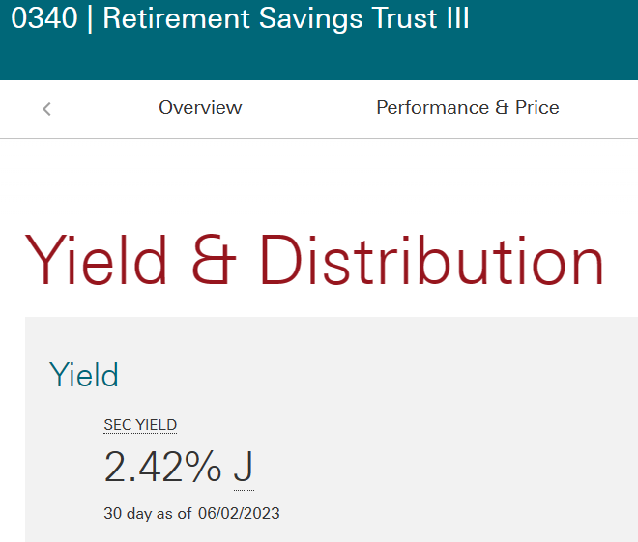
Stable Value Fund Net Credit Rates are unchanged despite the surge in interest rates
VGRST III Comparison
June 2023 to June of 2024:
No gain despite 500 bps rate increase
In Fed Funds Rate
We believe this trend will continue until
Late 2025 when short term rates are in the
2.5% range . At present SV Fund returns are
Impacted by mark to market write-downs
That are put into the crediting rate plan
Participants are paid

Slide 9

Back Tested Performance : SafeHaven Mid Duration outperforms Vanguard RT III in 1,3 and 5- year periods
Old but interesting: SafeHaven product structure kept up with SV Funds BEFORE rates went up
SafeHaven Short Duration Product outperforms
Fidelity FDRXX in all historical periods
SafeHaven performance over historical periods has been estimated by utilizing the 10-year history of Brokerage FDIC Insured Gross Bank Deposit yield from our affiliated taxable product with $50bb AUM
Duration adjustments are made to a 2.5-year duration and additional adjustments are made for premiums banks pay for core deposits compared to the brokered deposits used in the brokerage version of the product. See appendix
Note: the brokerage FDIC Insured product performed during the financial crisis despite some bank failures while Stable Value Funds were technically insolvent for long periods because of the then dubious value of their wrap guarantees.
Comparisons based on Vanguard Retirement Savings Trust Class III Stable value Fund
As of Sept 30th, 2019 , and based upon Fidelity Government Money Fund FDRXX as of 9-30- 2019

Slide 10

SafeHaven FDIC Insured Common Investment Trust Operating Model
IRI Integrates all product functions
Places cash deposits with Banks
Wholesaler to Investment Advisor
Investment
Investment Advisor
DC Plan
Deposit maturity and rate
DC
RECORD
KEEPER
BANKS
Place deposits
Common
Investment
Trust
Service
Provider
Contributions
Individual participant interest and principle
FDIC Insurance
Interest Principle
FDIC Insurance
Participant contributions are amalgamated into bulk deposits and placed with up to 10 banks
Bank deposits have laddered maturities to maximize rate of return , one bank is the liquidity bank
FDIC Insurance passes thru to the participant

